Slide 1

6th Grade Accelerated Math
Unit 6, Lesson 10 Dividing Integers Using Integer Chips Volume 1, pg. 278

Slide 2


Benchmark
MA.6.NSO.4.2
Apply and extend previous understandings of operations with whole numbers to multiply and divide integers with procedural fluency.
volume 1, pg. 278

Slide 3
Integrated Mathematical Thinking and Reasoning Standards
MA.K12.MTR.5.1 Use patterns and structure to help understand and connect mathematical concepts.
volume 1, pg. 278

Slide 4

Learning Target
I can use integer chips and patterns to discover rules for dividing integers.
volume 1, pg. 278

Slide 5

Warm-Up
volume 1, pg. 278

Slide 6

6.10.1 Warm-Up: Notice and Wonder
Write down one thing you notice about the picture.
Write down one thing you wonder about the picture.
Isaac described the image as a math fail. Why do you think he described it that way?
volume 1, pg. 278

Slide 7

Guided Instruction
volume 1, pg. 279

Slide 8
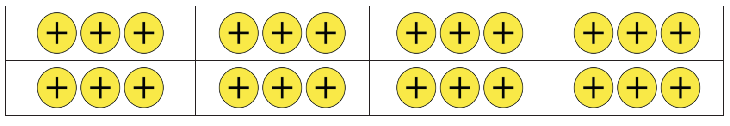
6.10.2 Guided Instruction: Using Integer Chips to Represent Division
Recall that division is repeated subtraction.
For example, 24 ÷ 8 can be expressed as 24 − 8 − 8 − 8 because 3 groups of 8 can be subtracted from 24.
This shows that 24 is made up of ____ groups of 8.
The expression 24 ÷ 8 can also be interpreted as dividing 24 into 8 equal-sized groups. In the representation shown, 24 positive integer chips are divided into 8 equal-sized groups.
The quotient is the result of the division, or the value of the integer chips in each group.
24 ÷ 8 = ____
volume 1, pg. 279

Slide 9
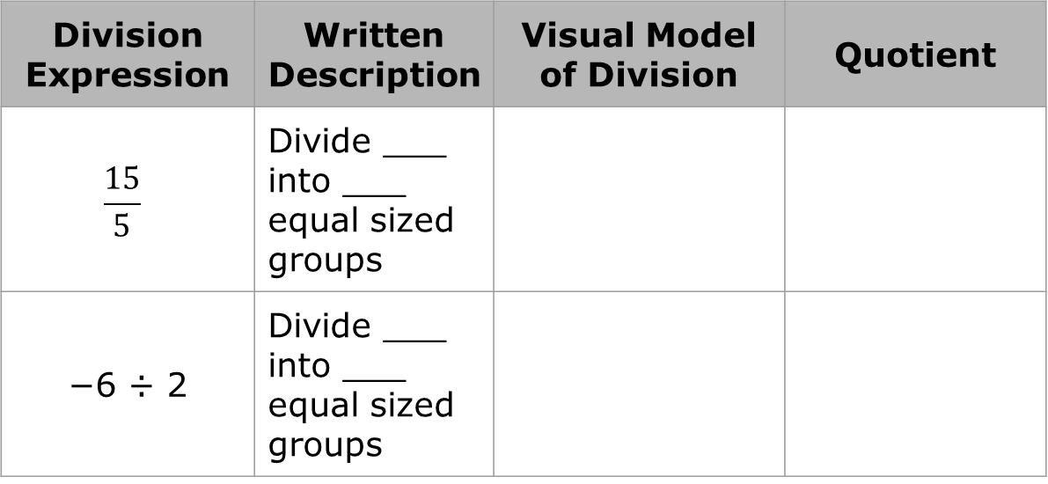

Complete the table to describe the division, then draw the visual model using integer chips, and determine the quotient.
Division Expression | Written Description | Visual Model of Division | Quotient
$$\frac{15}{5}$$ | Divide ___ into ___ equal sized groups
−6 ÷ 2 | Divide ___ into ___ equal sized groups
When modeling division with integer chips, the divisor must be positive, as this indicates the number of groups needed. When the divisor is negative, the expression can be rewritten using opposites.
For example, $\frac{8}{−2}$can be rewritten as $\frac{−8}{2}$because $\frac{8}{−2}$ = $\frac{−8}{2}$.
volume 1, pg. 279

Slide 10
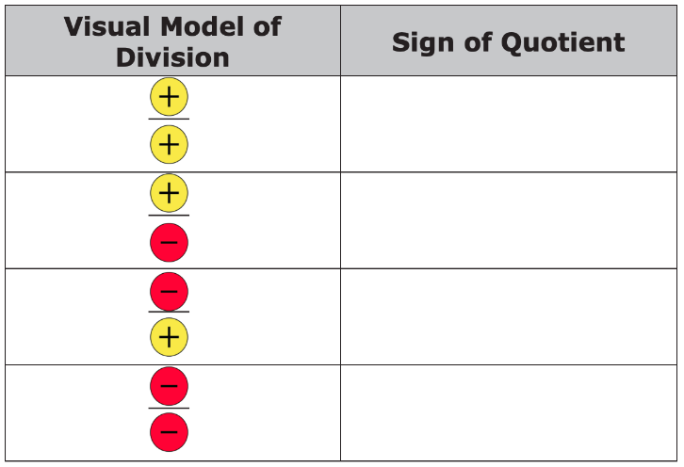
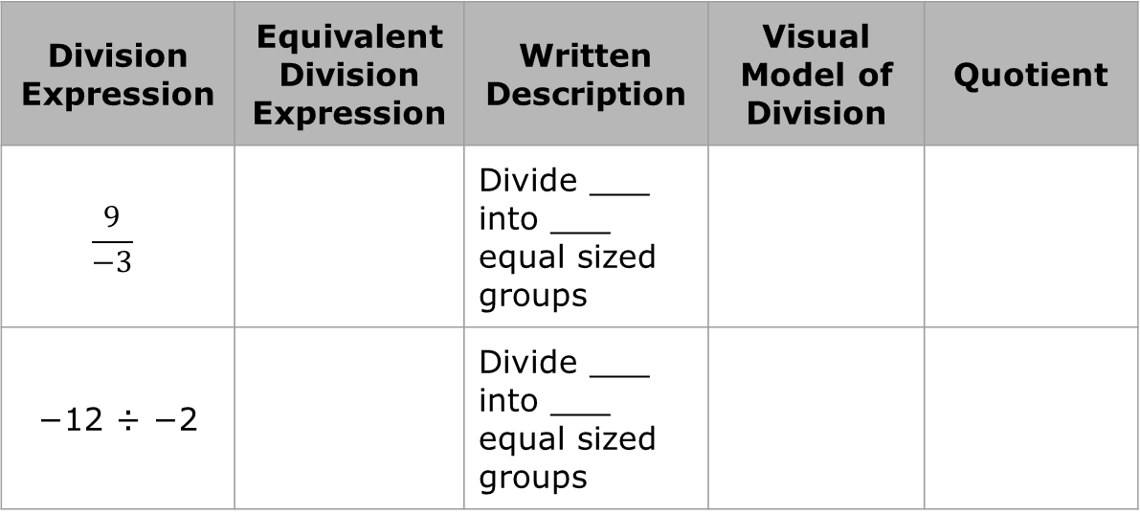
2.
Division Expression | Equivalent Division Expression | Written Description | Visual Model of Division | Quotient
$$\frac{9}{−3}$$ |  | Divide ___ into ___ equal sized groups
−12 ÷ −2 |  | Divide ___ into ___ equal sized groups
Use the pattern of the division in the tables to complete the rules by drawing the sign of the quotient as an integer chip.
volume 1, pg. 280

Slide 11

Collaboration
volume 1, pg. 280

Slide 12

6.10.3 Collaboration: How Are Integer Multiplication and Division Related?
Jeannie and Solimar were discussing the relationship between
5 × −2 = −10 and (−10) ÷ (−2) = 5.
Solimar said, “The multiplication equation can be interpreted as 5 groups of −2 and the division equation can be interpreted as how many groups of −2 are in −10. Isn’t that basically the same thing?”
Jeannie replied, “I agree. I also think it is interesting to see how the rules seem to be related. In the multiplication equation, we are multiplying a positive by a negative and the answer is a negative. In the division equation, we do the reverse of the multiplication problem and find that a negative divided by a negative is a positive.”
Solimar said, “Yeah, that’s a cool connection. Do you think the rules are the same for multiplication and division?”
Jeannie said, “I think they might be related to each other.”
volume 1, pg. 280

Slide 13
Discuss Solimar and Jeannie’s conversation with your partner.
Create two integer division equations that can be rewritten with the related multiplication equation.
Division Equation | Related Multiplication Equation
volume 1, pg. 280

Slide 14

Bring It Together
volume 1, pg. 281

Slide 15

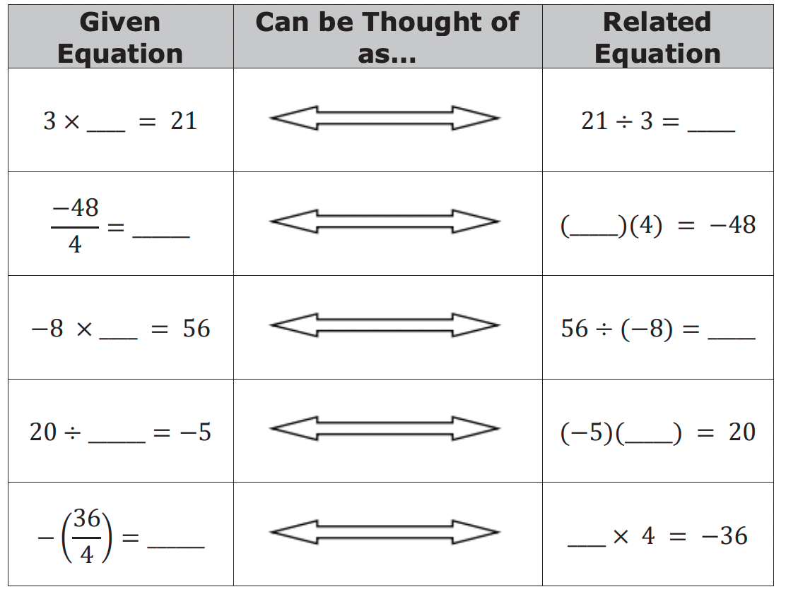
6.10.4 Bring It Together: How Are Integer Multiplication and Division Related?
Write the missing factor in each given equation. Then, write the related division or multiplication equation.
How are rules for multiplication of integers related to the rules for division of integers?
volume 1, pg. 281

Slide 16
Collaboration
volume 1, pg. 281

Slide 17
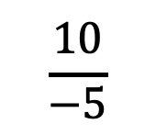
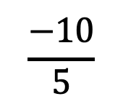
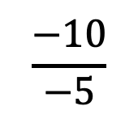
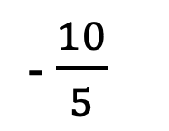
6.10.5 Collaboration: Which One Doesn’t Belong?
Circle the expression that does not belong with the other three.
$$\frac{10}{−5}$$
$$\frac{−10}{5}$$
$$\frac{−10}{−5}$$
- $\frac{10}{5}$
Explain why the expression does not belong.
Verify your answers with your partner and, if necessary, resolve any differences.
volume 1, pg. 281

Slide 18
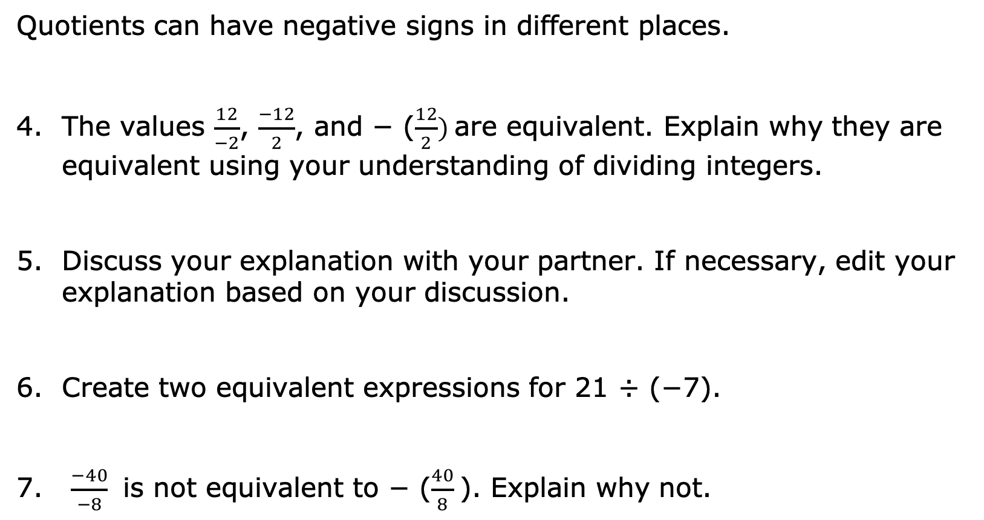
Quotients can have negative signs in different places.
The values $\frac{12}{−2}$, $\frac{−12}{2}$, and − ($\frac{12}{2})$are equivalent. Explain why they are equivalent using your understanding of dividing integers.
Discuss your explanation with your partner. If necessary, edit your explanation based on your discussion.
Create two equivalent expressions for 21 ÷ (−7).
$\frac{−40}{−8}$ is not equivalent to − ($\frac{40}{8}$). Explain why not.
volume 1, pg. 281

Slide 19

Guided Practice
volume 1, pg. 282

Slide 20

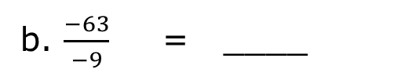
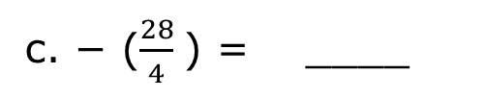
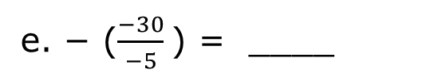
6.10.6 Guided Practice: Dividing Integers
1. Find each quotient.
a. 12 ÷ −4 = ____
b. $\frac{−63}{−9}$ = ____
c. − ($\frac{28}{4}$) = ____
d. 60 ÷ 5 = ____
e. − ($\frac{−30}{−5}$) = ____
2. Create two expressions equivalent to $\frac{−20}{10}$.
3. What is the value of the expressions above?
volume 1, pg. 282

Slide 21

Your Turn
volume 1, pg. 282

Slide 22
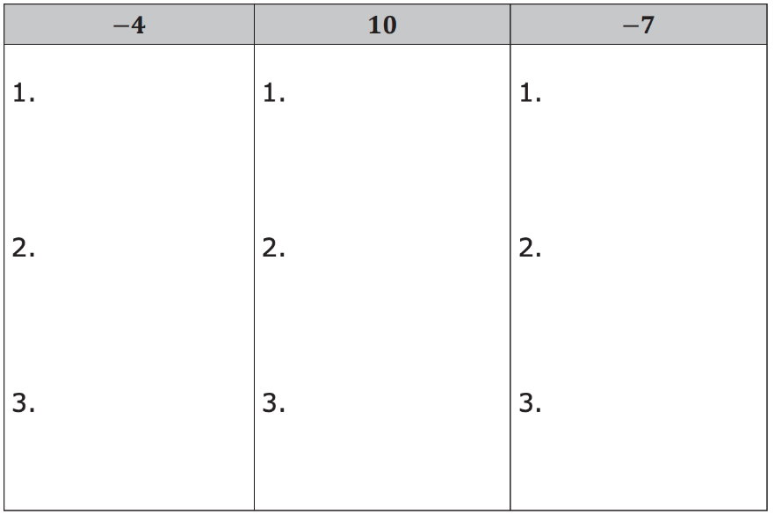
6.10.7 Your Turn!
In each column below, create three different division expressions that would result in the given quotient.
volume 1, pg. 282

Slide 23

Wrap-Up
volume 1, pg. 283

Slide 24
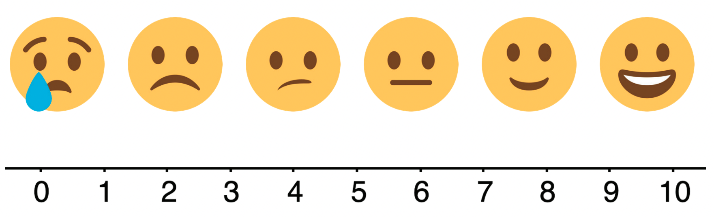
6.10.8 Wrap-Up: Reflection
Use the emoji scale to indicate your level of confidence with understanding and using the rules for multiplying and dividing integers.
volume 1, pg. 283

